Slide 1


Seci1143
Probability & statistical data analysis
CHAPTER 1
Introduction to Statistics
Innovating Sustainable Solutions
Notes:
prepared by Razana Alwee / edited by Suhaila Mohamad Yusuf

Slide 2
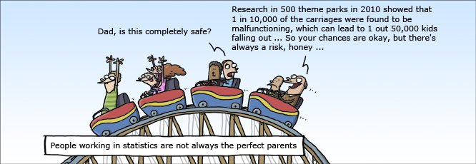
Introduction to Statistics
What is STATISTICS?
Notes:
prepared by Razana Alwee / edited by Suhaila Mohamad Yusuf

Slide 3


Introduction to Statistics

Slide 4
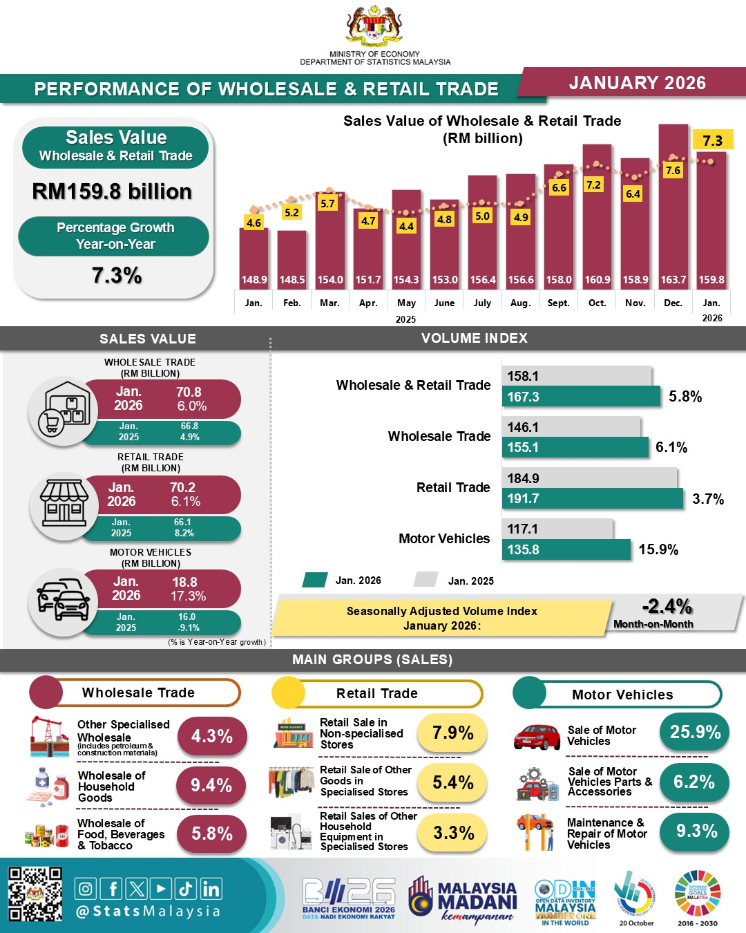
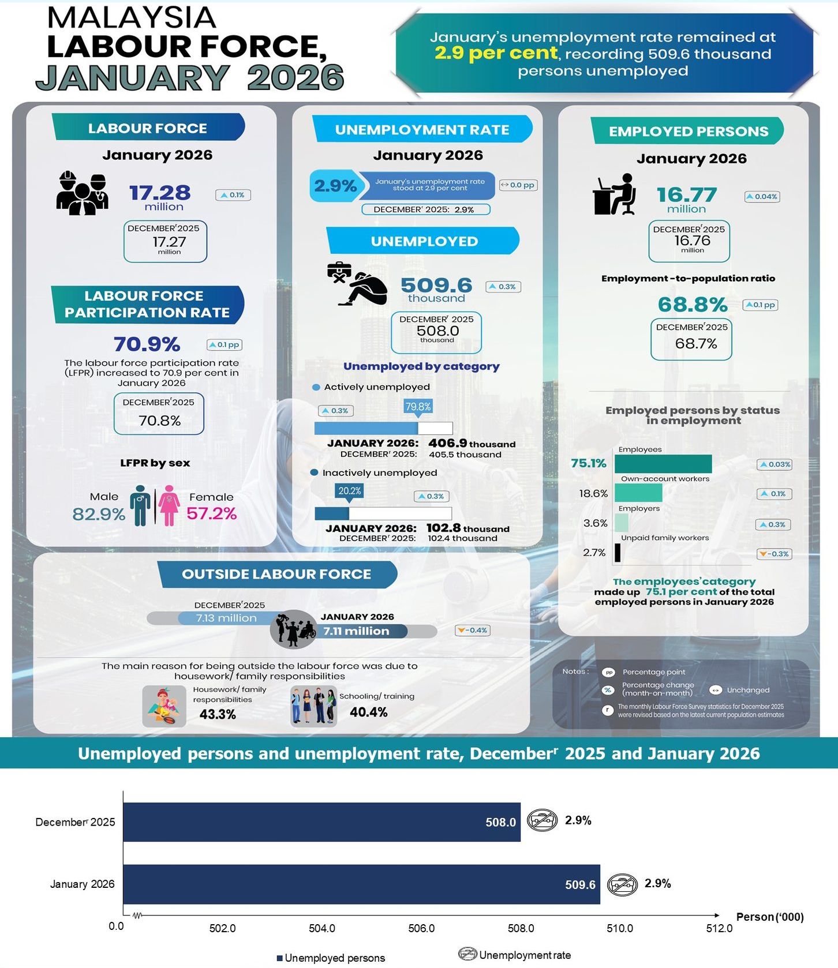
Introduction to Statistics

Slide 5
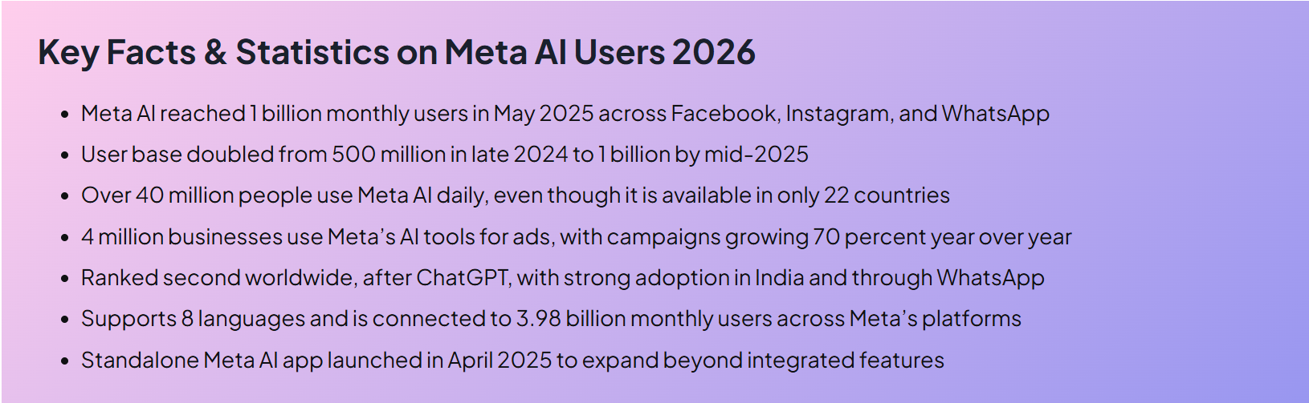
Introduction to Statistics
Visit for more info, https://www.affiliatebooster.com/meta-ai-users/

Slide 6
Introduction to Statistics
Even though you may not have realized it, you probably have made some statistical statements in your everyday conversation or thinking.
Statements like "I sleep for about eight hours per night on average" and "You are more likely to pass the exam if you start preparing earlier" are actually statistical in nature.

Slide 7
Introduction to Statistics
We encounter data and conclusions based on data every day.
Statistics is the scientific discipline that provides methods to help us make sense of data.
Statistical methods are used in business, medicine, agriculture, social sciences, natural sciences, and applied sciences, such as engineering.
The field of statistics teaches us how to make intelligent judgments and informed decisions in the presence of uncertainty and variation.

Slide 8
Introduction to Statistics
Statistics is the scientific application of mathematical principles to the collection, analysis, and presentation of numerical data.
Statistics is a discipline which is concerned with:
designing experiments and other data collection,
summarizing information to aid understanding,
drawing conclusions from data, and
estimating the present or predicting the future.
There are 2 main branches of statistics:
Descriptive
Inferential

Slide 9
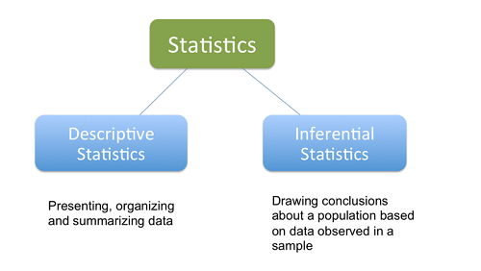
Introduction to Statistics

Slide 10
Introduction to Statistics
Descriptive statistics are used to describe the basic features of the data gathered from an experimental study in various ways.
The techniques are commonly classified as:
Graphical description in which we use graphs to summarize data.
Tabular description in which we use tables to summarize data.
Parametric description in which we estimate the values of certain parameters which we assume to complete the description of the set of data.

Slide 11
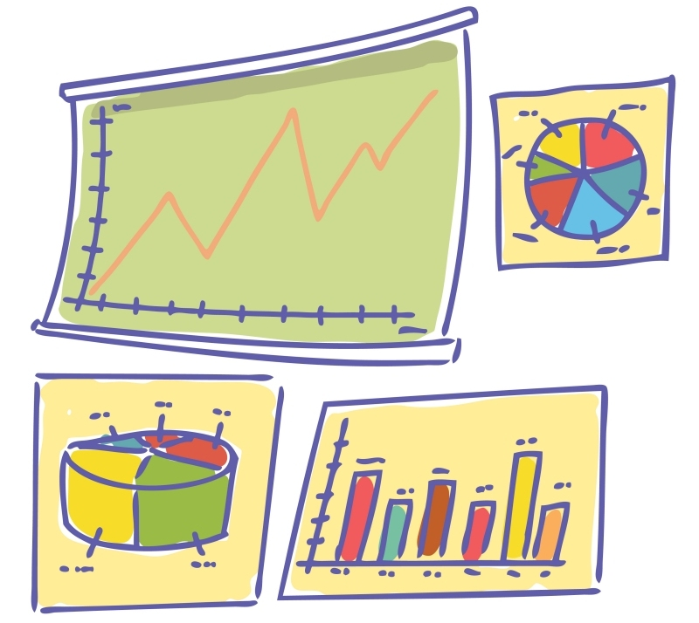
Descriptive Statistics
Graphical description
Example:
Graph
Bar chart
Pie chart

Slide 12
Descriptive Statistics
Tabular description
Example:
Frequency Table
Score | Frequency
0 | 2
1 | 5
2 | 8
3 | 6
4 | 4
5 | 3

Slide 13
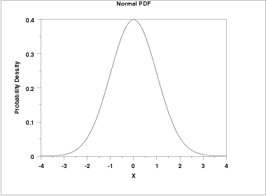
Descriptive Statistics
Parametric description
Mean | μ
Median | μ
Mode | μ
Range | Infinity in both directions.
Standard Deviation | σ
Skewness | 0
Kurtosis | 3

Slide 14
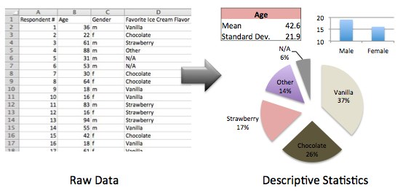
Example

Slide 15
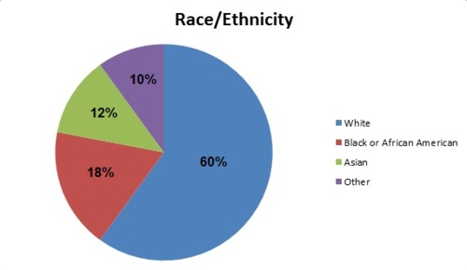
Example

Slide 16
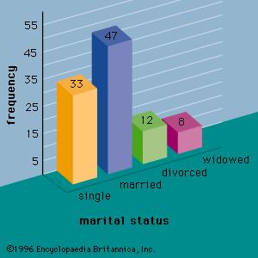
Example

Slide 17
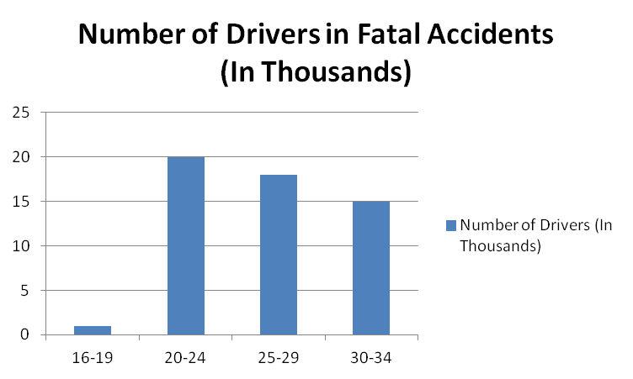
Example

Slide 18
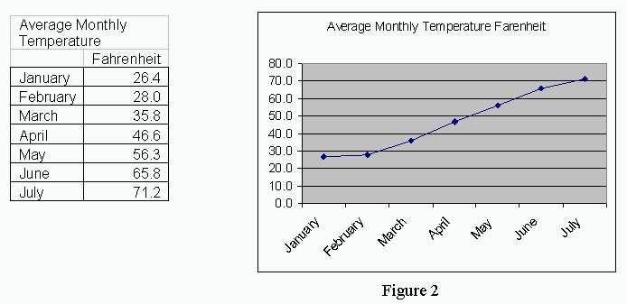
Example

Slide 19
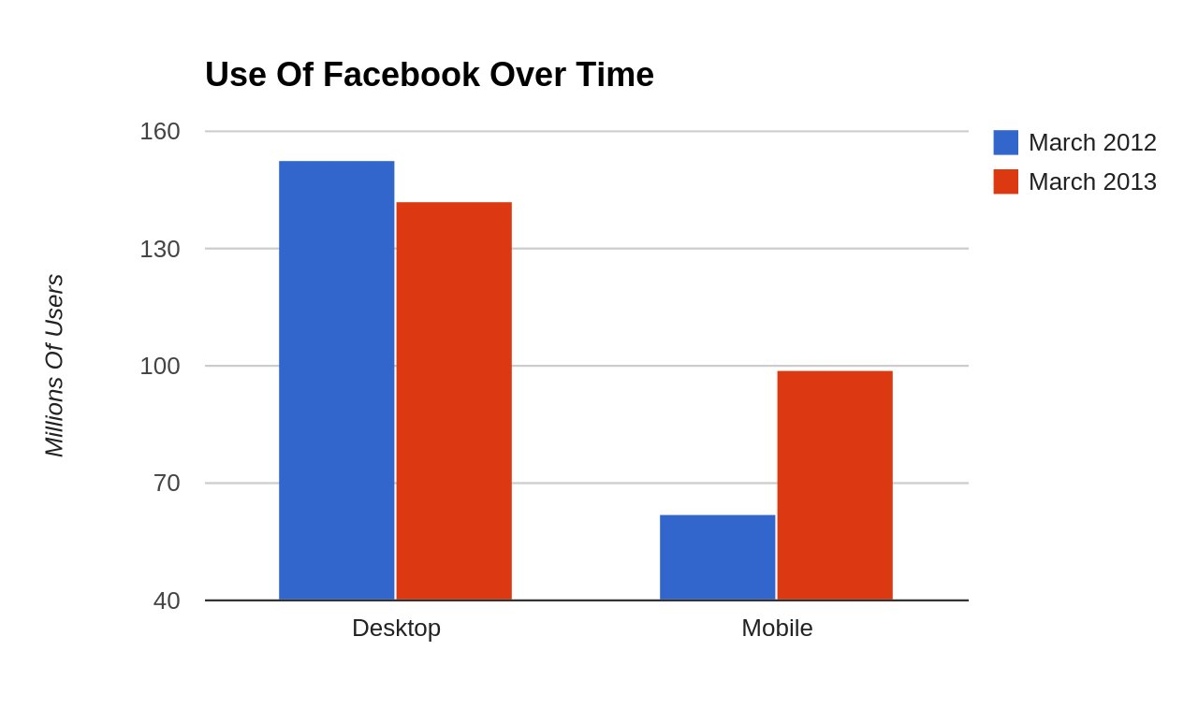
Example

Slide 20
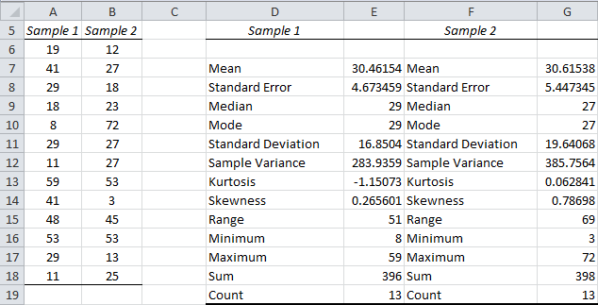
Example

Slide 21
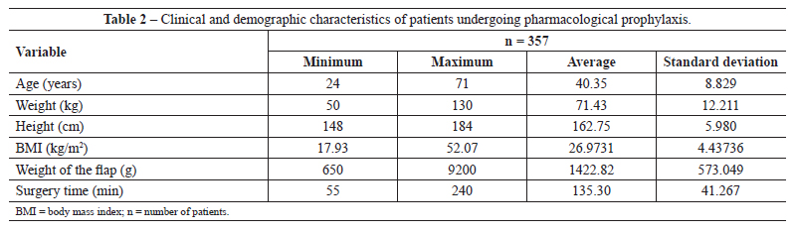
Example

Slide 22
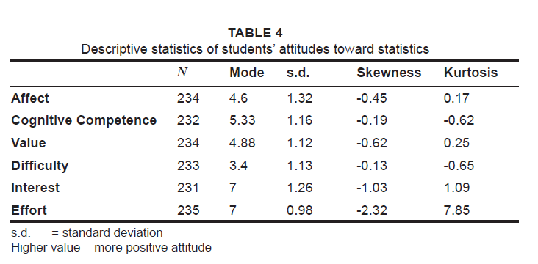
Example

Slide 23
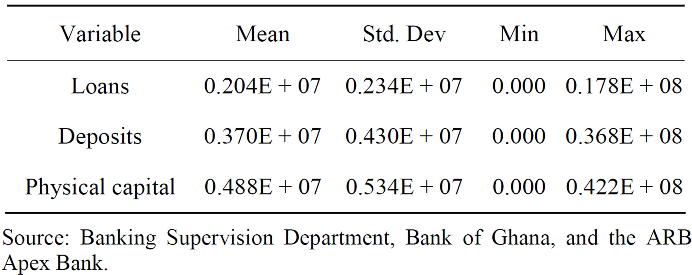
Example

Slide 24
Introduction to Statistics
Inferential statistics are used to draw inferences about a population from a sample.
It includes:
point estimation
interval estimation
hypothesis testing (or significance testing)
prediction

Slide 25
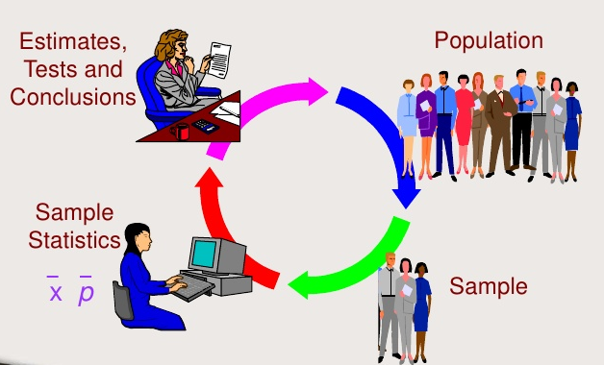
Inference Process

Slide 26
Introduction to Statistics
Population
Sample

Slide 27

Population & Sample

Slide 28
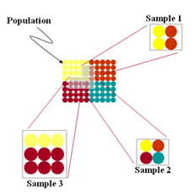
Population & Sample
The entire collection of individuals or object about which information is desired is called the population of interest.
A sample is a subset of the population, selected for study in some prescribed manner

Slide 29
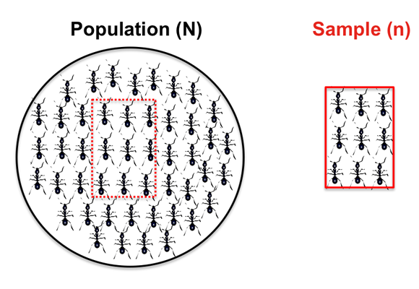
Population & Sample

Slide 30
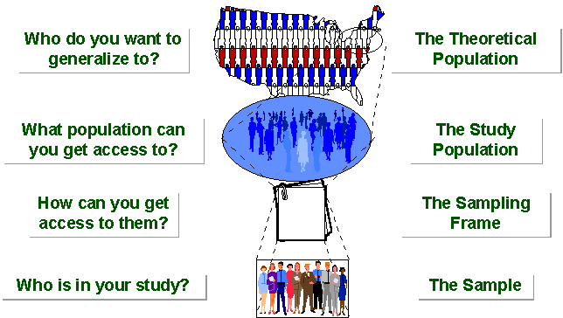
Population & Sample

Slide 31
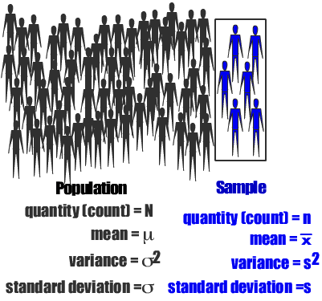
Population & Sample

Slide 32
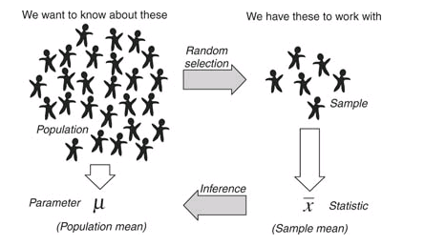
Population & Sample

Slide 33
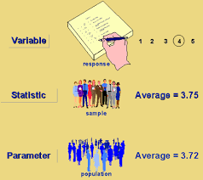
Example

Slide 34
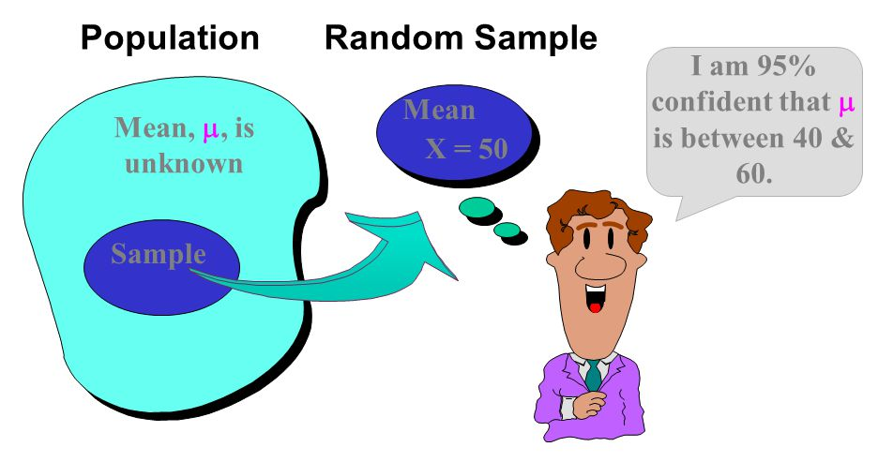
Example

Slide 35
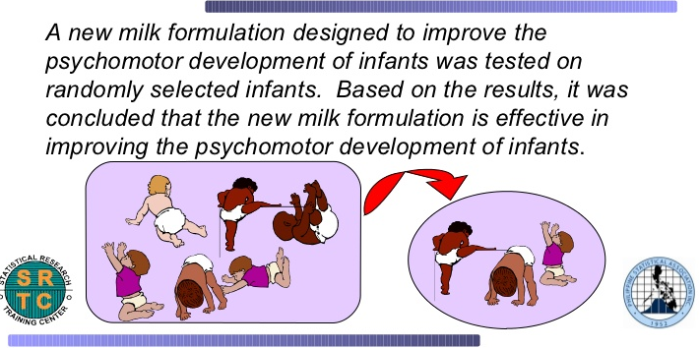
Example

Slide 36
Data Analysis Process

Slide 37
Data Analysis Process
Statistics involves the collection and analysis of data.
Both task are critical.
Raw data without analysis are of little value, and even a sophisticated analysis cannot extract meaningful information from data that were not collected in a sensible way.
The data analysis process can be viewed as a sequence of steps that lead from planning to data collection to informed conclusions based on the resulting data.

Slide 38
Data Analysis Process
6 steps:
Understanding the nature of the problem
Deciding what to measure and how to measure it
Data collection
Data summarization and preliminary analysis
Formal data analysis
Interpretation of results

Slide 39
Data Analysis Process
Understanding the nature of the problem
An understanding of the research problem
Know the goal of the research and what questions we hope to answer
Have a clear direction before gathering data to lessen the chance of being unable to answer the questions of interest using the data collected.

Slide 40

Data Analysis Process
Deciding what to measure and how to measure it
In some cases, the choice is obvious, e.g. in a study of the relationship between the weight of a football player and position played, you would need to collect data on player weight and position.

Slide 41
Data Analysis Process
but in other cases the choice of information is not as straightforward, e.g. in a study of the relationship between preferred learning style and intelligence, how would you define learning style and measure it and what measure of intelligence would you use?
It is important to carefully define the variables to be studied and to develop appropriate methods for determining their values.

Slide 42
Data Analysis Process
Data collection
Decide whether an existing data source is adequate or whether new data must be collected.
If a decision is made to use existing data (secondary data), it is important to understand how the data were collected and for what purpose.
If new data are to be collected (primary data), a careful plan must be developed.
The type of analysis that is appropriate and subsequent conclusions that can be drawn depend on how the data are collected.

Slide 43
Data Analysis Process
Data summarization and preliminary analysis
Summarizing the data graphically and numerically
This initial analysis provides insight into important characteristics of the data and can provide guidance in selecting appropriate methods for further analysis.

Slide 44
Data Analysis Process
Formal data analysis
Select and apply the appropriate inferential statistical methods.
Interpretation of results
What conclusions can be drawn from the analysis?
How do the result of the analysis inform us about the stated research problem or question?
How can our results guide future research?

Slide 45
Primary & Secondary Data
Secondary data is data which has been collected by individuals or agencies for purposes other than those of our particular research study.
For example, if a government department has conducted a survey of, say, family food expenditures, then a food manufacturer might use this data in the organization's evaluations of the total potential market for a new product.
Primary data, by contrast, are collected by the investigator conducting the research.

Slide 46
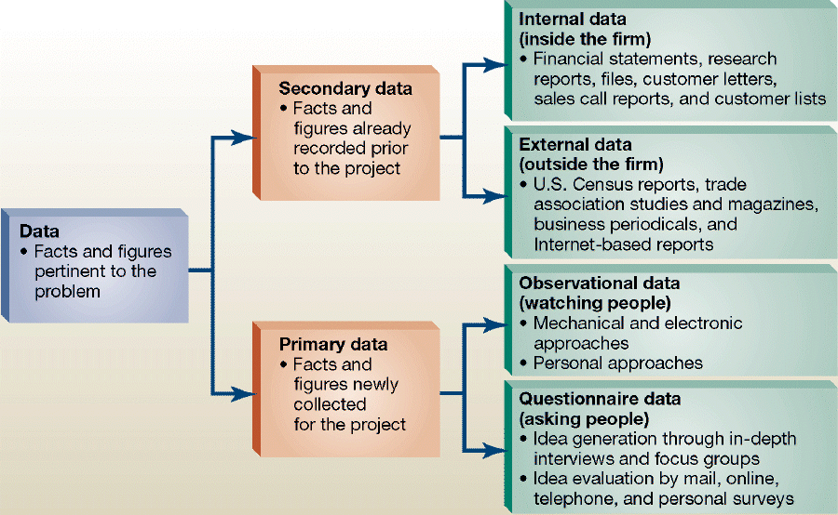
Primary & Secondary Data

Slide 47
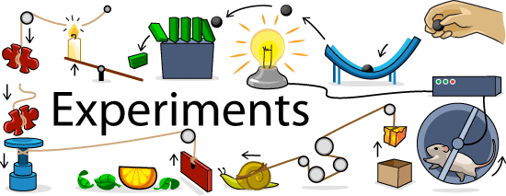


Data Sources
Primary data: Experiment
Primary data: Survey (Questionnaire, Interview)

Slide 48





Data Sources
Secondary data: existing databases, record review

Slide 49
Qualitative & Quantitative Data
Qualitative Data | Quantitative Data
Overview: Deals with descriptions. Data can be observed but not measured. Colors, textures, smells, tastes, appearance, beauty, etc. Qualitative → Quality | Overview: Deals with numbers. Data which can be measured. Length, height, area, volume, weight, speed, time, temperature, humidity, sound levels, cost, members, ages, etc. Quantitative → Quantity

Slide 50

Qualitative & Quantitative Data
Example 1:
Oil Painting
 | Qualitative data: blue/green color, gold frame smells old and musty texture shows brush strokes of oil paint peaceful scene of the country masterful brush strokes
 | Quantitative data: picture is 10" by 14" with frame 14" by 18" weighs 8.5 pounds surface area of painting is 140 sq. in. cost $300

Slide 51

Qualitative & Quantitative Data
Example 2:
Latte
 | Qualitative data: robust aroma frothy appearance strong taste burgundy cup
 | Quantitative data: 12 ounces of latte serving temperature 150º F. serving cup 7 inches in height cost $4.95

Slide 52
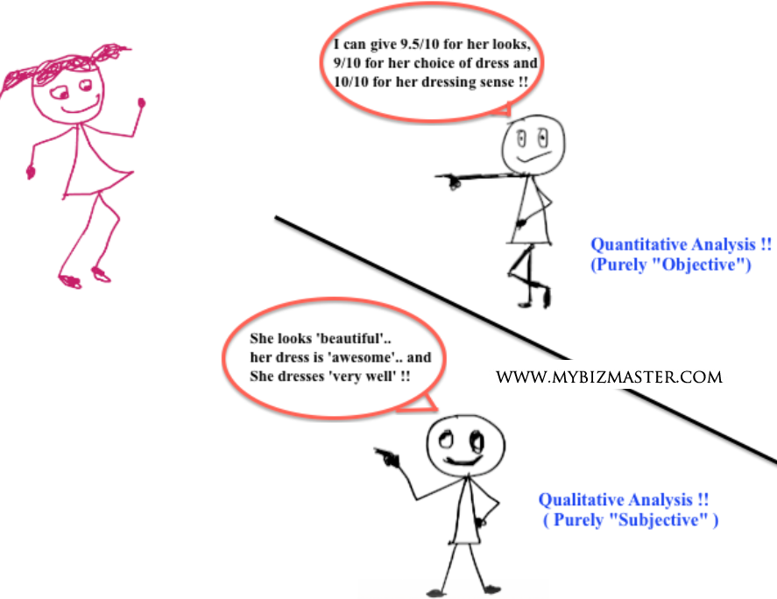
Qualitative & Quantitative Data

Slide 53
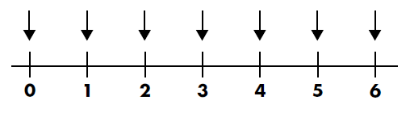
Discrete & Continuous Data
Discrete data can only take on certain individual values.
Continuous data can take on any value in a certain range.

Slide 54
Discrete & Continuous Data
Example 1
Number of pages in a book is a discrete variable.
Example 2
Length of a film is a continuous variable.
Example 3
Shoe size is a Discrete variable. E.g. 5, 5½, 6, 6½ etc. Not in between.

Slide 55


Discrete & Continuous Data
Example 4
Temperature is a continuous variable.
Example 5
Number of people in a gathering is a discrete variable.
Example 6
Time taken to run a race is a continuous variable.

Slide 56
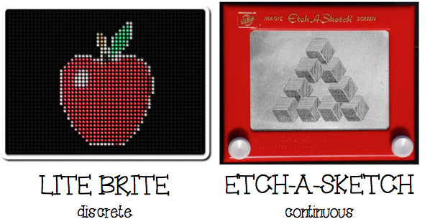
Discrete & Continuous Data

Slide 57
Discrete & Continuous Data
Group the following as either discrete or continuous data.
Speed of a car
Volume of a cereal box
Population of a town
Length of a crocodile
Shirt collar size
Discrete? Continuous?
Number of matches in a box
Number of goals in a season
Temperature of oven

Slide 58

Discrete & Continuous Data
How about money? Is it a discrete or continuous data?

Slide 59
Levels of Measurement
There are four levels of data measurement. Ranked from top to bottom in order of complexity and information content these are:
Nominal scale
Ordinal scale
Interval scale
Ratio scale

Slide 60
Levels of Measurement
Each level of measurement is characterized by its properties.
Nominal measurement has just one property: CLASSIFICATION.
Ordinal measurement has two properties: CLASSIFICATION and ORDER.
Interval measurement has three properties: CLASSIFICATION, ORDER and EQUAL INTERVALS.
Ratio data has four properties: CLASSIFICATION, ORDER, EQUAL INTERVALS and TRUE ZERO.

Slide 61
Levels of Measurement - Nominal Scales
Properties: classification
Observations reflect: differences in kind
Examples: gender, ethnic background, major in college
Nominal measurement is simply concerned with sorting observations into categories.
Because the single property of nominal data is classification it tells us nothing about differences in degree or amount.

Slide 62
Levels of Measurement - Nominal Scales
Numbers assigned to categories (as identification codes) have no numeric value (we cannot add, subtract, divide or multiply nominal data) and any ordering of categories is arbitrary.
This is the most primitive form of measurement. The presence vs. absence of something is a form of nominal measurement (“do you smoke?” YES, NO).
Although it is considered a form of measurement the collection of nominal data is more easily thought of as a sorting method.

Slide 63
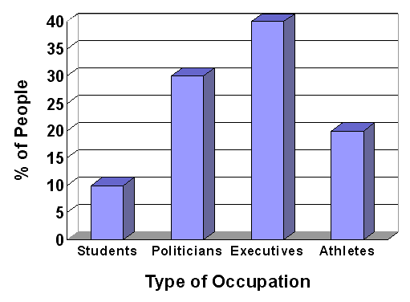
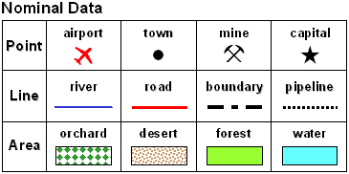
Levels of Measurement - Nominal Scales

Slide 64
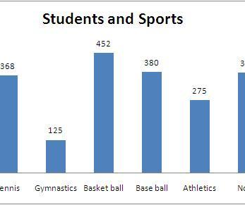
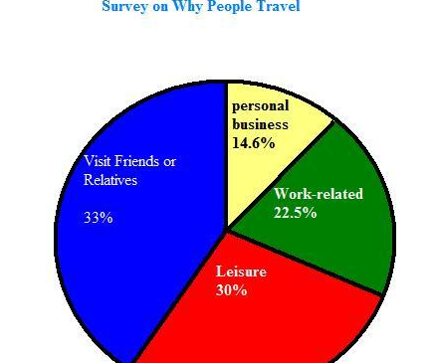
Levels of Measurement - Nominal Scales

Slide 65
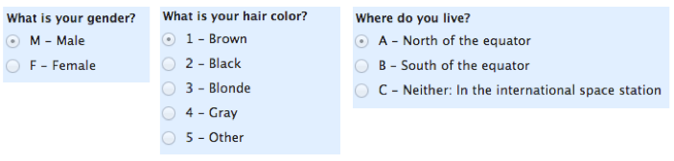
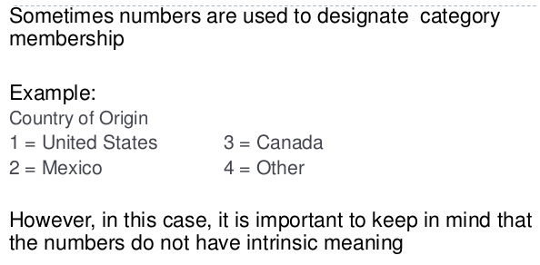
Levels of Measurement - Nominal Scales

Slide 66
Levels of Measurement - Ordinal Scales
Properties: classification, order Observations reflect: differences in degree Examples: Likert scale categories, rankings, academic letter grade, stages in development
The distinctive property of ordinal measurement is order.
On a typical Likert Scale “strongly agree” represents more agreement than “agree”. However, we do not know how much more.

Slide 67
Levels of Measurement - Ordinal Scales
Example: The Likert Scale
 | Strongly Agree | Agree | Neither | Disagree | Strongly Disagree
If the price of raw materials fell firms would reduce the price of their food products. | 1 | 2 | 3 | 4 | 5
Without government regulation the firms would exploit the consumer. | 1 | 2 | 3 | 4 | 5
Most food companies are so concerned about making profits they do not care about quality. | 1 | 2 | 3 | 4 | 5
The food industry spends a great deal of money making sure that its manufacturing is hygienic. | 1 | 2 | 3 | 4 | 5
Food companies should charge the same price for their products throughout the country | 1 | 2 | 3 | 4 | 5

Slide 68
Levels of Measurement - Ordinal Scales
Similarly if Comedian A is ranked 1st for funniness, and Comedian B is ranked 4th we have no way of knowing how much funnier Comedian A is than Comedian B.
We cannot assume that they are four times funnier.
They may be more or less than four times funnier.
But we do know that they are more funny than Comedian B, and more funny than the comedians ranked 2nd and 3rd places as well.
We know about order but we have no information about the size of the interval between points.

Slide 69
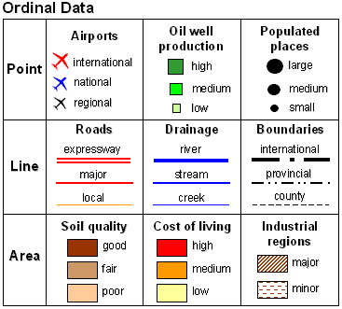
Levels of Measurement -Ordinal Scales
Example

Slide 70
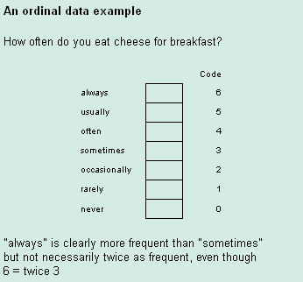
Levels of Measurement - Ordinal Scales
Example

Slide 71
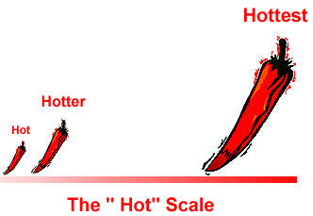
Levels of Measurement - Ordinal Scales
Example

Slide 72
Levels of Measurement - Interval Scales
Properties: classification, order, equal intervals Observations reflect: measurable differences in amount Examples: IQ scores, degrees of temperature,
Essentially, interval data are ordinal, but they have an extra property - the ability to meaningfully add and subtract measurements.
In interval-scaled data, the gaps between the numbers are comparable, unlike with ordinal data.
Any interval has the same meaning regardless of its location on the scale. "X is five inches longer than Y" has meaning regardless of the values of X and Y.

Slide 73
Levels of Measurement - Interval Scales
However, ratios are meaningless on an interval scale because an interval scale has no true zero.
Temperature scales are an example of this, so are decibel scales.
Zero degrees Fahrenheit does not mean the total absence of temperature.
Zero decibels does not mean there is no sound.

Slide 74
Levels of Measurement - Interval Scales
Furthermore, if it is 80 degrees outside today and it was only 40 degrees outside yesterday we cannot say that today is twice as hot as yesterday.
Similarly a sound level of 80 dB is not twice as loud as a sound level of 40 dB.
In short, if the data can be ordered and the arithmetic difference is meaningful, then the data are at least interval data.

Slide 75
Levels of Measurement - Ratio Scales
Properties: classification, order, equal intervals, true zero Observations reflect: measurable differences in total amount Examples: weight, income, family size, number of cows in a field
Ratio data are the highest form of data measurement and the form we are most familiar with.
For ratio data both differences and ratios are interpretable.
Ratio data have a natural zero.

Slide 76
Levels of Measurement - Ratio Scales
Examples of ratio scale data are number of computers you own, weight, height, a bank balance, number of people watching a movie, goals scored by Brazil in the World Cup, etc.
Ratio data look a lot like interval data.
However, the zero point has a special meaning in ratio-scaled data: it indicates the absence of whatever property is being measured.

Slide 77
Levels of Measurement - Ratio Scales
Ratio data always have the flavor of counting: when you measure the amount of money that you have, you are counting up coins and bills.
When you are measuring your height, you are counting the number of inches off the ground to the top of your head.
Both ratio and interval data make use of a wide range of statistical analysis tools.

Slide 78
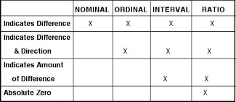
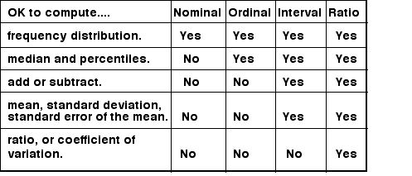
Levels of Measurement -

Slide 79
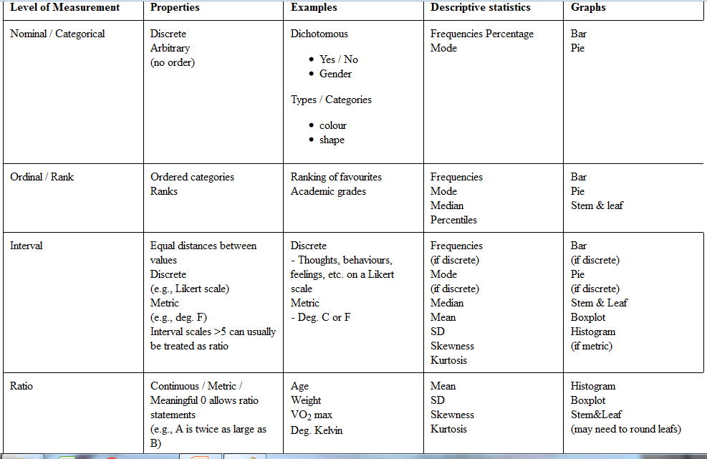

Slide 80
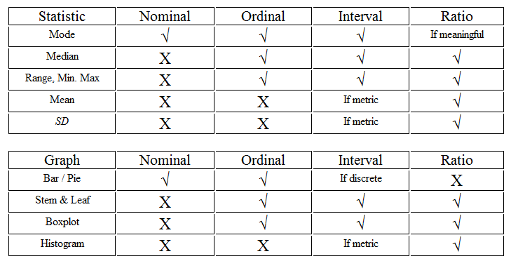
Levels of Measurement

Slide 81
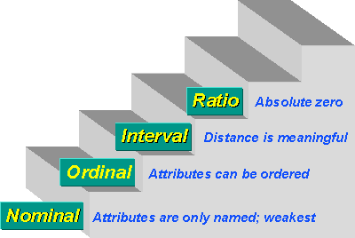
Levels of Measurement
"You can have data without information, but you cannot have information without data." —Daniel K. Moran

Slide 82
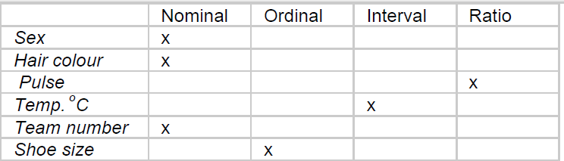
Example

Slide 83
Exercise
Identify the following as nominal level, ordinal level, interval level, or ratio level data.
1. Flavours of frozen yogurt
2. Amount of money in savings accounts
3. Students classified by their reading ability: Above average, Below average, Normal
4. Letter grades on an English essay
5. Religions
6. Commuting times to work
7. Ages (in years) of art students
8. Ice cream flavour preference
9. Years of important historical events
10. Instructors classified as: Easy, Difficult or Impossible

Slide 84
